Slide 1
Exoskeleton Arm using McKibben Muscle Actuator
Session: 2024-2025
DEPARTMENT OF MECHANICAL ENGINEERING
Maulana Azad National Institute of Technology,
Bhopal (462003)
Mentor: Submitted By:
Dr. Deepak Kumar Aman Narwade (2211601309)
(Assistant Professor) Chetan Dhakar (2211601104)
Rajendra Singh (2211601345)
Ravindra Kumar (2211601356)

Slide 2
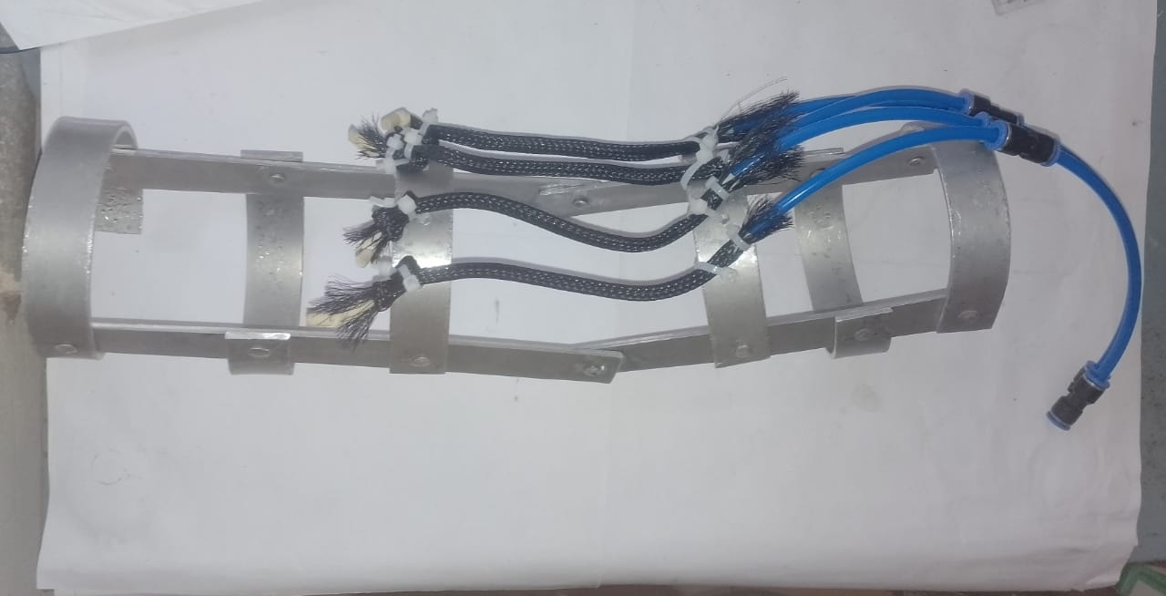
Introduction
Lifting heavy weights can cause strain and injury to the
muscles and joints of the human body.
Exoskeleton can provide external support by reducing the
strain on the joints and muscles, and increasing the capacity
to lift more.
The motivation for developing a single arm exoskeleton for
increasing the capacity to lift heavy objects or weights is to
reduce strain on worker and reduce the chances of injury and
increase the productivity of workers in industries where heavy
lifting is required.

Slide 3
Objectives
To identify the design requirements for a single arm
exoskeleton that can help in heavy lifting.
The proposed exoskeleton uses a dynamic model of the
musculoskeletal system of the lower leg combined with
dynamic from a pneumatic actuators to provide resistive
forces to the muscle forces.

Slide 4
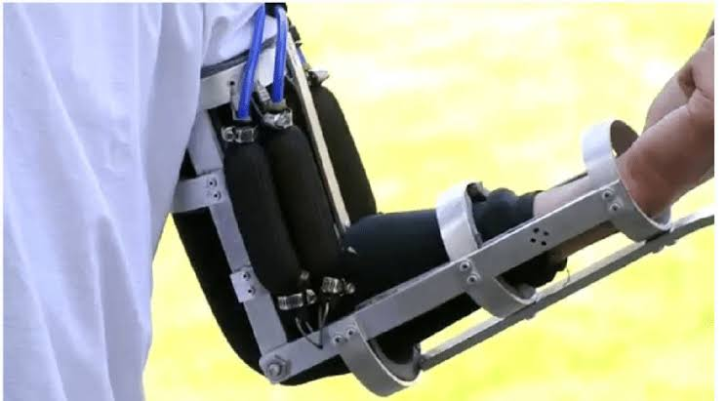
Literature Summary
McKibben muscles mimic human muscles
Used in many studies for wearable robotics
Applications in rehabilitation and industrial lifting
High power-to-weight ratio
Challenges: speed and precise control

Slide 5
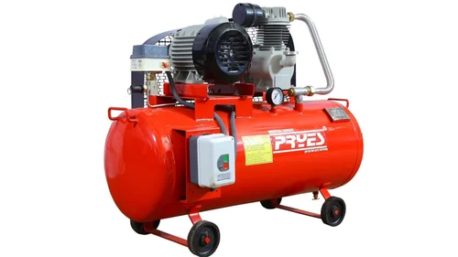
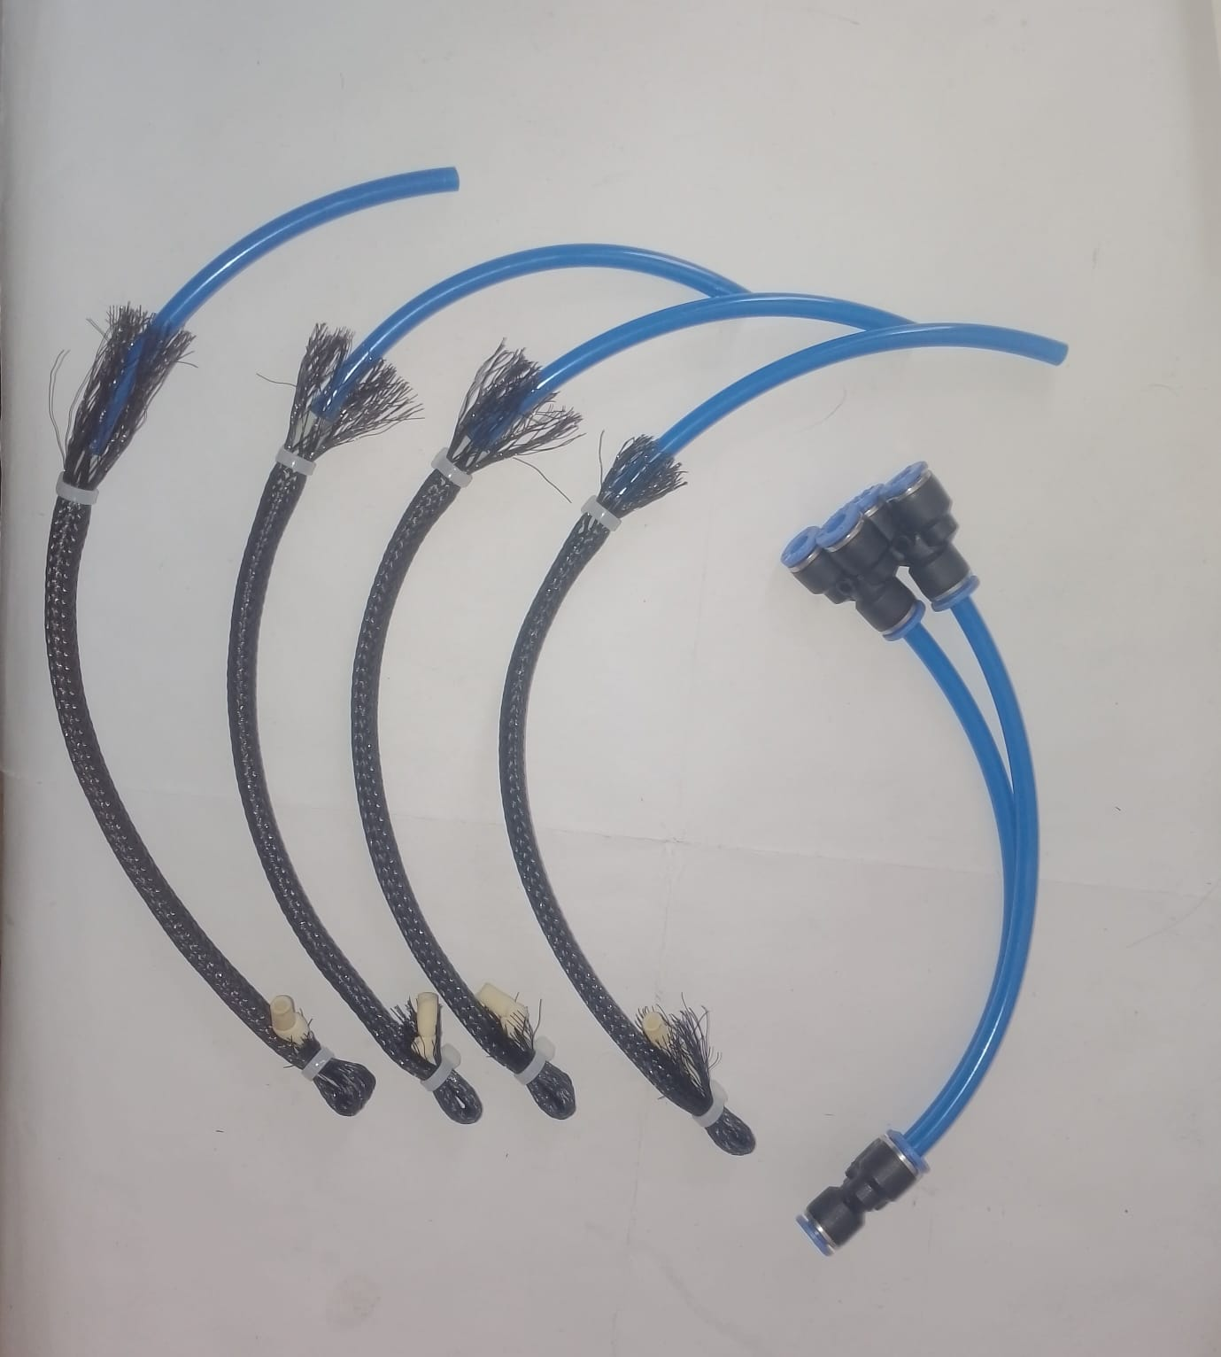
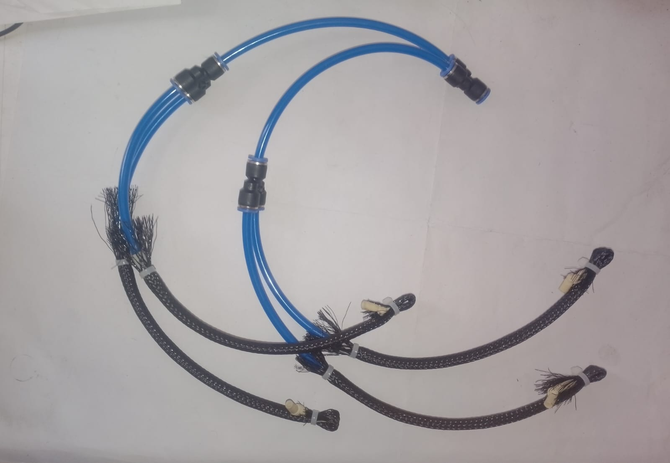
Methodology
1. Design of Frame – Focused on making the structure lightweight and
wearable for user comfort and ease of movement.
2. McKibben Muscle Placement – Ensures that artificial muscles are
aligned with human muscles to mimic natural movement.
3. Air Supply System – Involves components like compressors, valves,
and tubing to power the pneumatic muscles.
4. Testing & Feedback – After building the exoskeleton, it should be
tested by users to check how well it works.

Slide 6
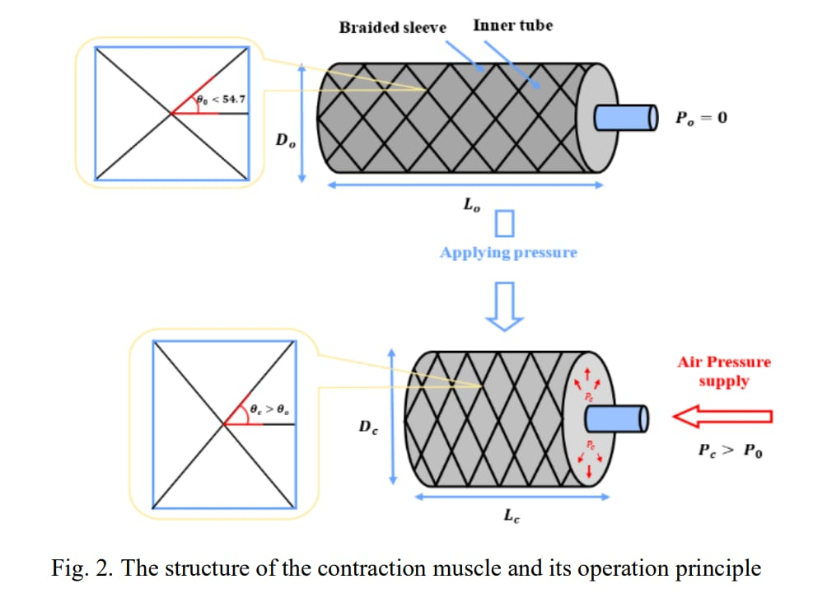
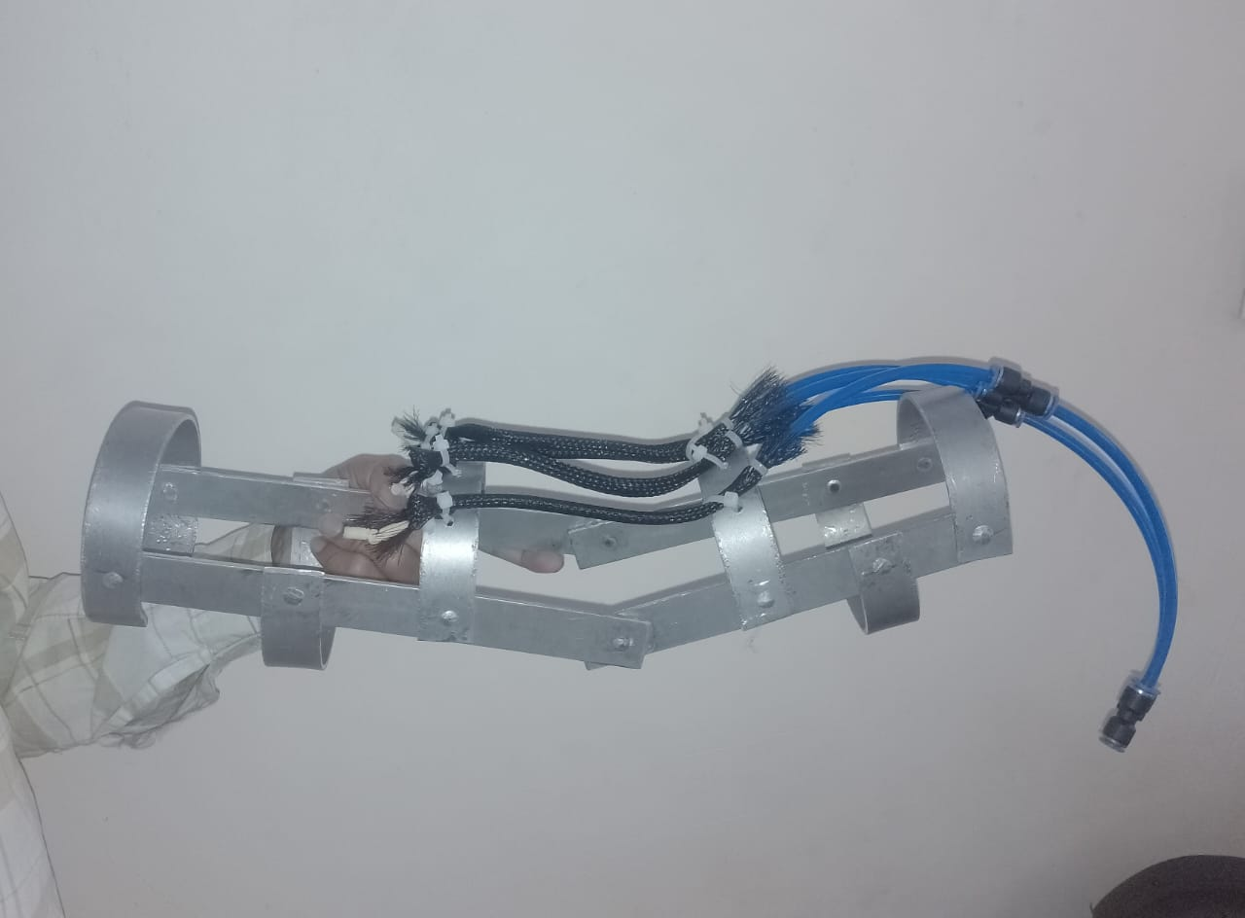
Working Principle
A pneumatically powered exoskeleton arm uses compressed air to actuate pneumatic artificial muscle, which then move the arm's joints, allowing the wearer to lift and manipulate objects with increased strength and ease.
Compressed Air Source: A compressor provides the compressed air that powers the exoskeleton.

Slide 7
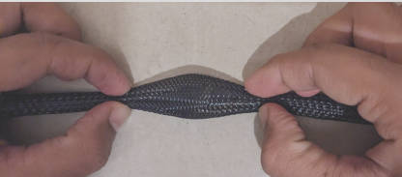
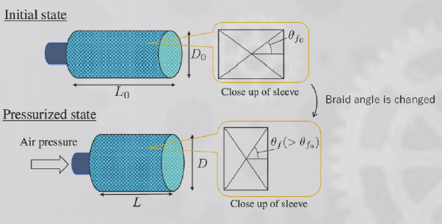
Pneumatic artificial muscle (Contractor type) : also known
as McKibben muscles, are lightweight, flexible actuators
mimicking biological muscles, using pressurized air to generate
force and motion.
Exoskeleton : To amplify human physical capacities and assist
with tasks by providing mechanical power and support, allowing
users to perform actions that would otherwise be difficult .

Slide 8
Results and Testing
Improved lifting capability
Reduced muscle strain
Comfortable for the user
Smooth and controlled motion

Slide 9
Conclusion
The exoskeleton arm proves to be an excellent assist
tool for the physically weak individuals.
The exoskeleton arm is just the beginning of a potential
power enhancing exoskeleton suit which is the
technology of the future
The fabricated pneumatically powered Human
Exoskeleton arm is economical (costing under Rs.
12,000), aesthetic, reliable, portable and ergonomic.

Slide 10
References
1. Tondu, B., & Lopez, P. (2000). "Modeling and Control of McKibben Artificial Muscle Robot Actuators." IEEE Control Systems Magazine, 20(2), 15–38.
2. Daerden, F., & Lefeber, D. (2002). "Pneumatic Artificial Muscles: Actuators for Robotics and Automation." European Journal of Mechanical and Environmental Engineering, 47(1), 10–21.
3. Caldwell, D. G., Medrano-Cerda, G. A., & Goodwin, M. J. (1995). "Control of Pneumatic Muscle Actuators." IEEE Control Systems, 15(1), 40–48.

Slide 11
Thank You

